Slide 1
Multispecies Swards Mechanisms for Diversity Effects
Version 1
Slides may change over time as new studies arise
Notes:
V1- created 7/7/23

Slide 2
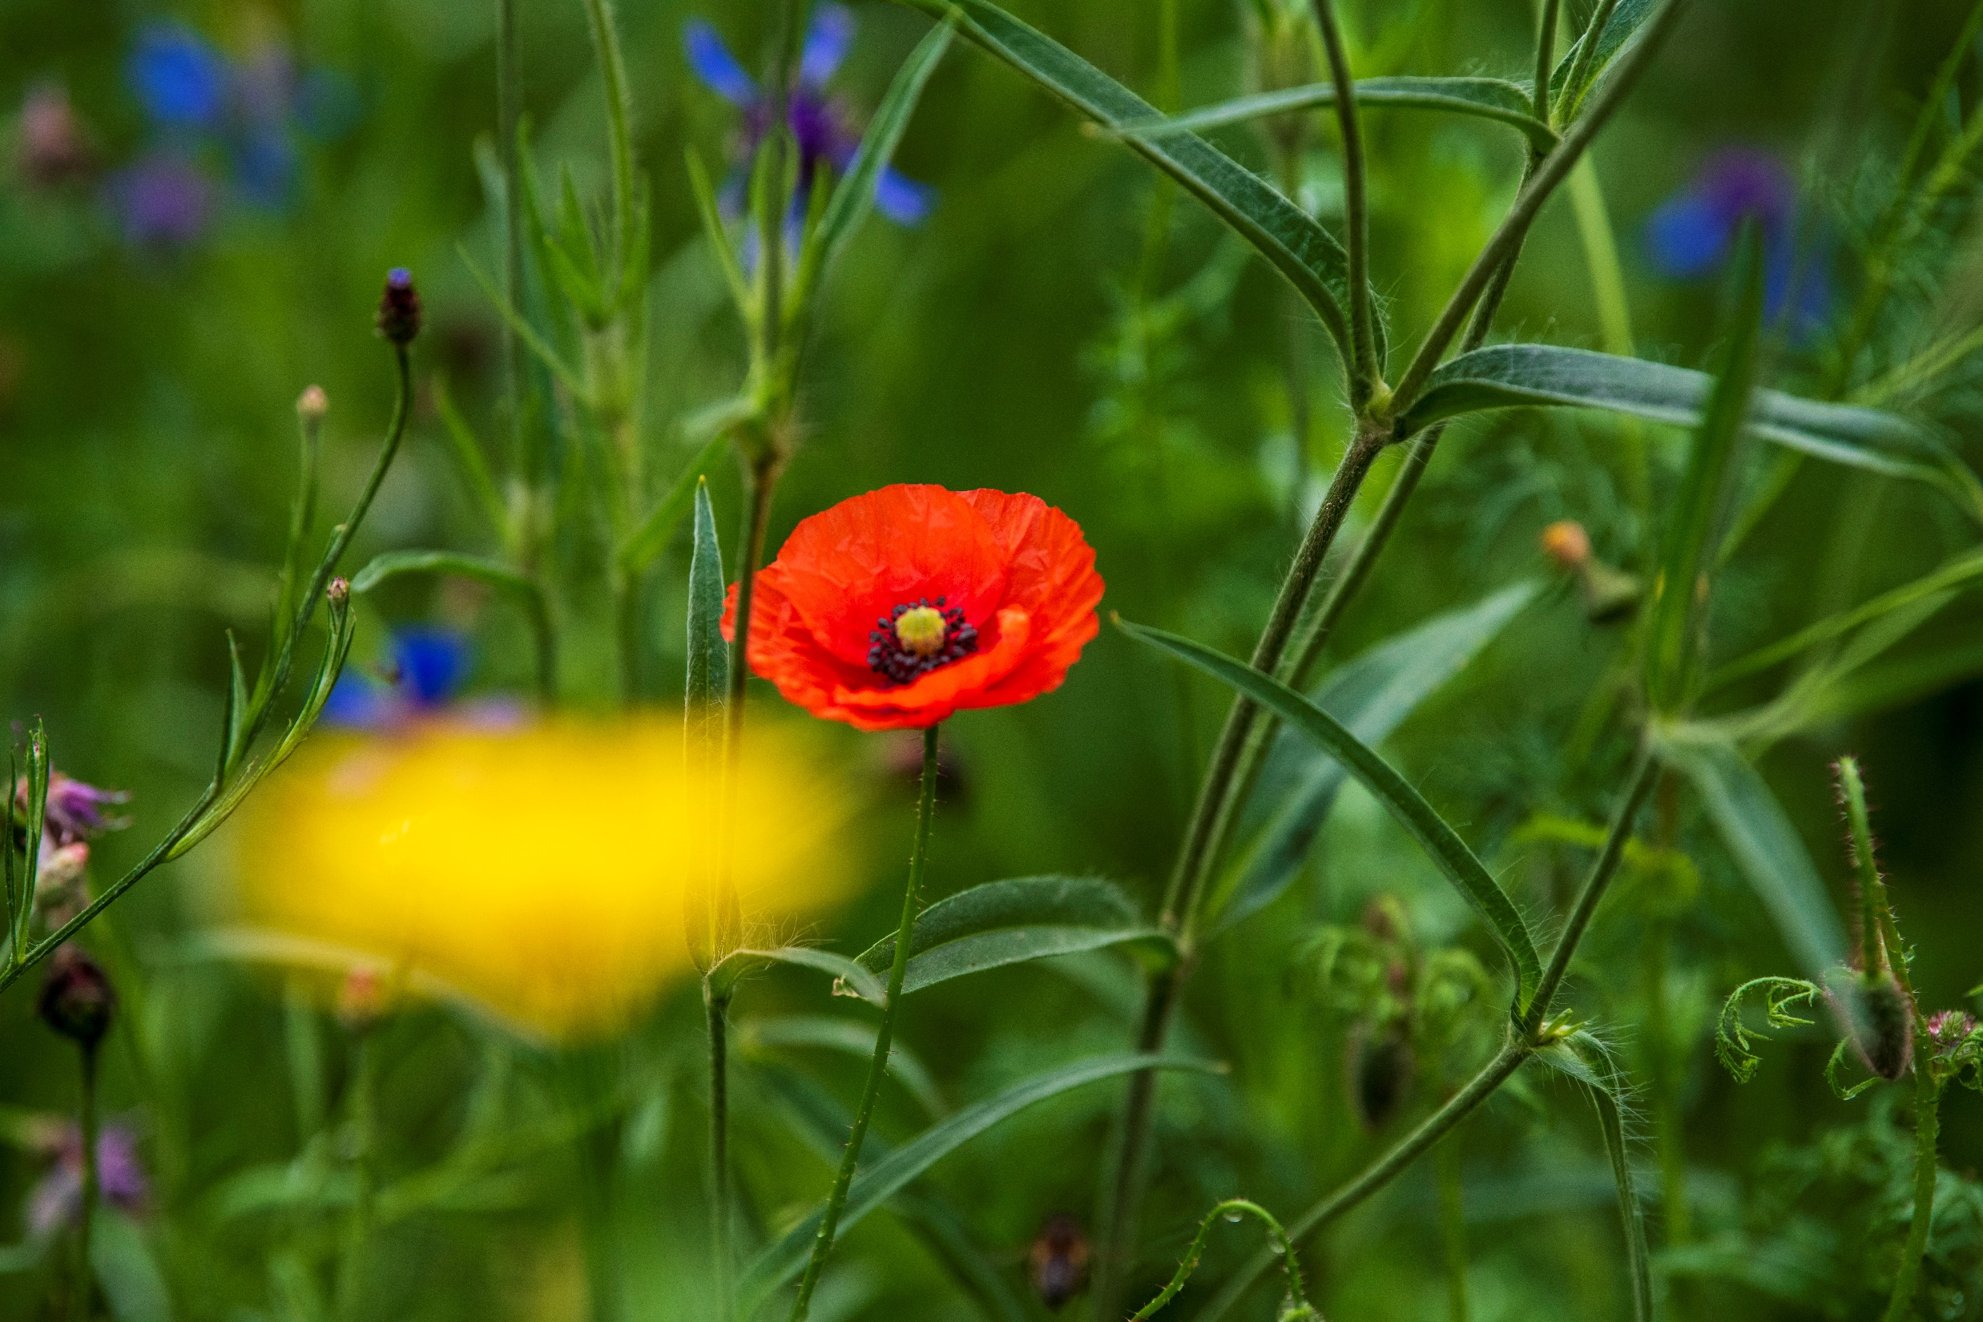
Multispecies Swards Mechanisms for Diversity Effects
Notes:
V1- created 7/7/23

Slide 3
Overview
Explore diversity effects in multispecies swards: overyielding and niche complementarity
Understand how functional trait differences lead to varied resource utilisation
Discuss facilitation and increased positive interactions between species
Highlight the importance of both above-ground and below-ground diversity

Slide 4
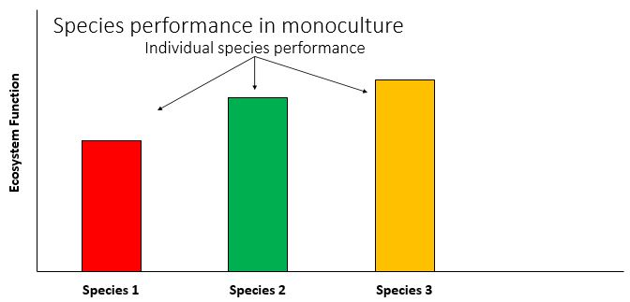
The Diversity Effect

Slide 5
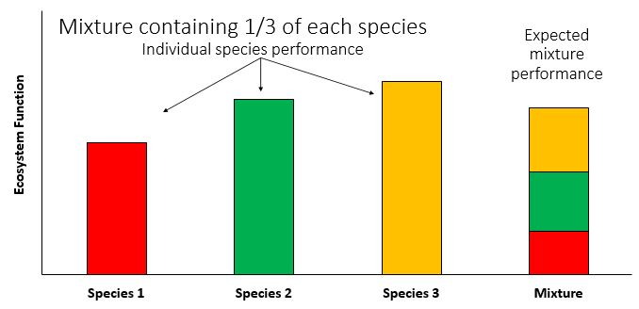
The Diversity Effect

Slide 6
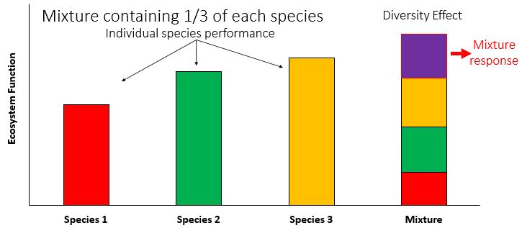
The Diversity Effect

Slide 7
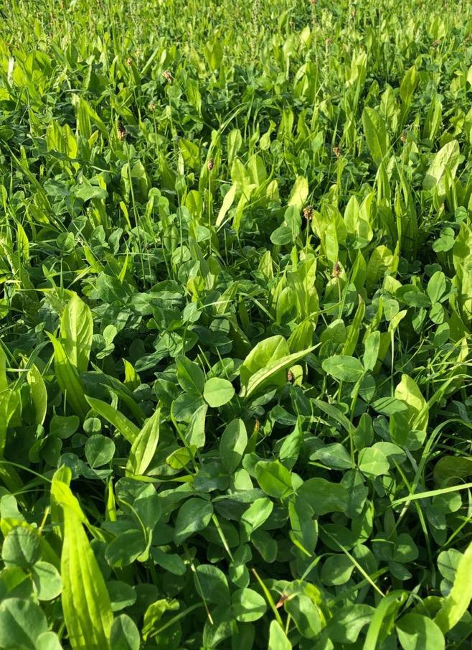
Mechanisms
Niche complementarity
Functional trait differences lead to resources being used differently
Facilitation
Increased positive interactions between species

Slide 8
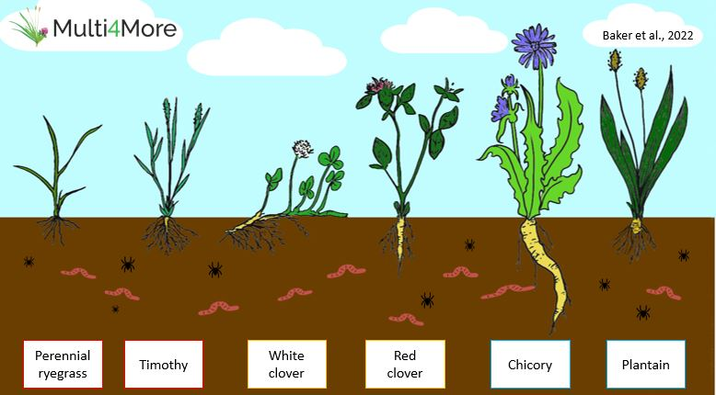
Illustration of species in a multispecies sward
Notes:
Diversity not only above ground in terms of plant architecture and seasonality, but also beneath the ground
The grasses provide stability to the soil, the clovers fix nitrogen
The deep tap roots of the red clover and chicory plants can also be seen here. These tap roots give the sward enhanced drought resistance by accessing water at lower soil levels. The large roots also help to improve soil quality by promoting aeration and water infiltration.

Slide 9
Thank you
Funded by
Supported by
https://multi4more.ie/
Project partners

