Slide 1
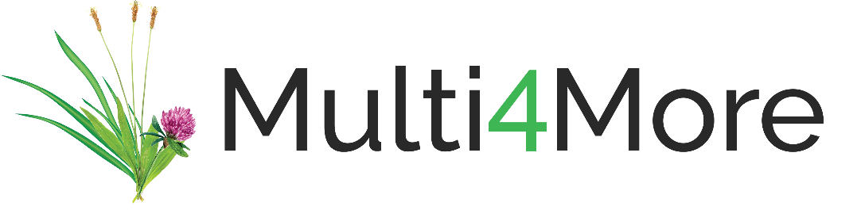
Multispecies Swards
Agronomic Performance
Version 1
Slides may change over time as new studies arise
Notes:
V1- created 7/7/23

Slide 2
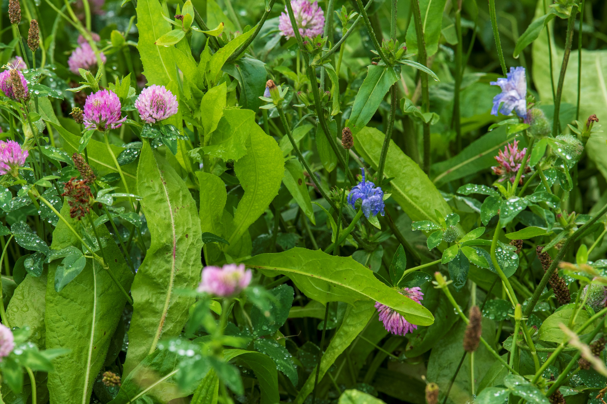
Multispecies Swards
Agronomic Performance
Notes:
V1- created 7/7/23

Slide 3

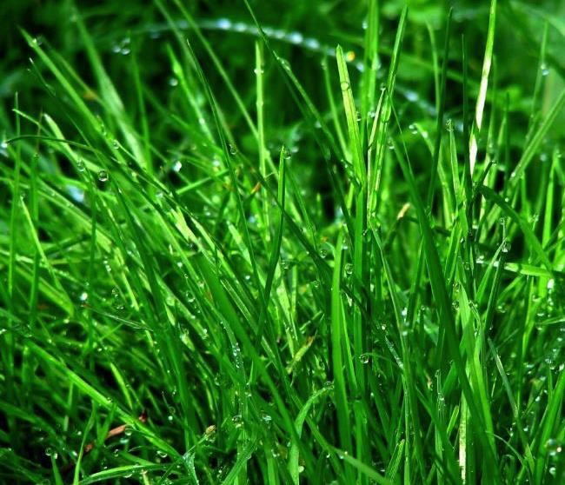
Overview
Forage yield results from multiple studies
Manipulations of plant diversity of grasses, legumes and herbs
Comparison of lower-diversity, high-nitrogen swards with higher-diversity, lower-nitrogen swards
Notes:
Agricultural grassland improvement in temperate regions has generally focused on the simplification and homogenisation of swards, resulting in increased reliance on Lolium perenne L. (perennial ryegrass) monocultures
L. perenne is among the most economically important grass species sown in temperate regions and accounts for 95% of national forage seed sales in Ireland with the remainder made up of white clover and Italian ryegrass. We all know the reasons for this i.e. excellent response to defoliation, high dm yields, reliable germination etc.
.

Slide 4
COST 852: ‘AgroDiversity’ expt.
  Objectives
  Agronomic species and sites
  Species richness (low levels)
  1, vs 4 species
  Species proportions systematically varied across mixtures:
  100, 25:25:25:25
  70:10:10:10, 40:40:10:10
  Methods
  Simplex design, 31 sites, 17 countries = 930 plots
+ Canada
Finn et al. 2013, J Appl Ecol
Notes:
COST Action 852 resulted in a common experiment ‘Agrodiversity Experiment’ being implemented across 30 sites in Europe, and a Canadian site. The performance of grassland monocultures was compared with systematically varying proportions of four species.
100% =monoculture
70:10:10:10 (and 10:70:10:10 etc.)
40:40:10:10 (and 40:10:40:10 etc.)
25:25:25:25 (equi-proportional mixture)
This provided a rare insight into the effect of varying evenness of the four species.
Same experimental protocol across 31 sites, 17 countries, 30 plots at each site = 930 plots in total.

Slide 5
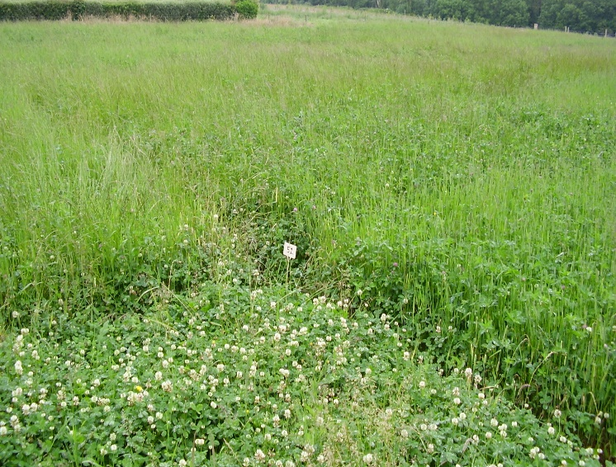
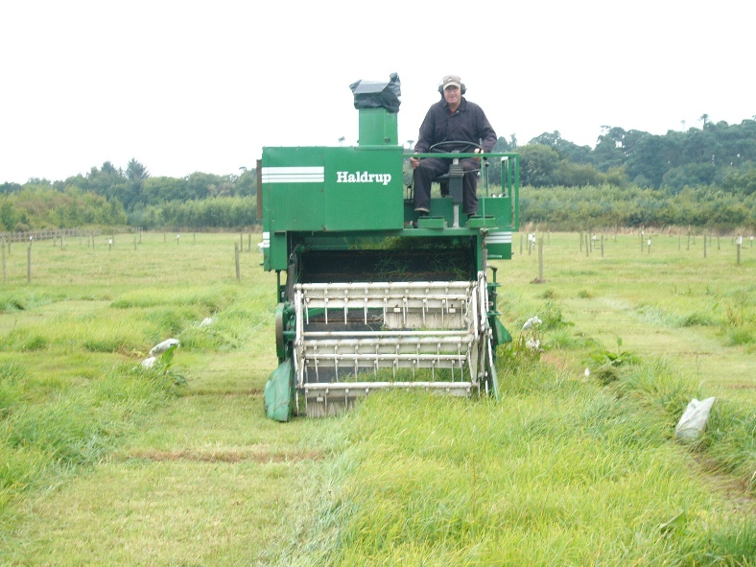
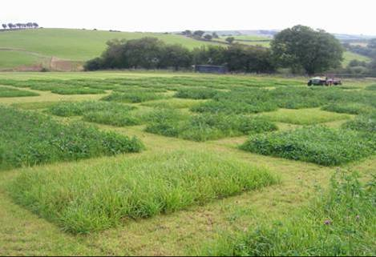
Results
Notes:
Sites were establishing by sowing.
Within each site, the same amount of fertiliser was applied to each plot.
Across sites, however, different sites chose different fertiliser levels that varied from 0 (organic sites) to 150 kg N per ha per year.
Harvested by mowing.

Slide 6
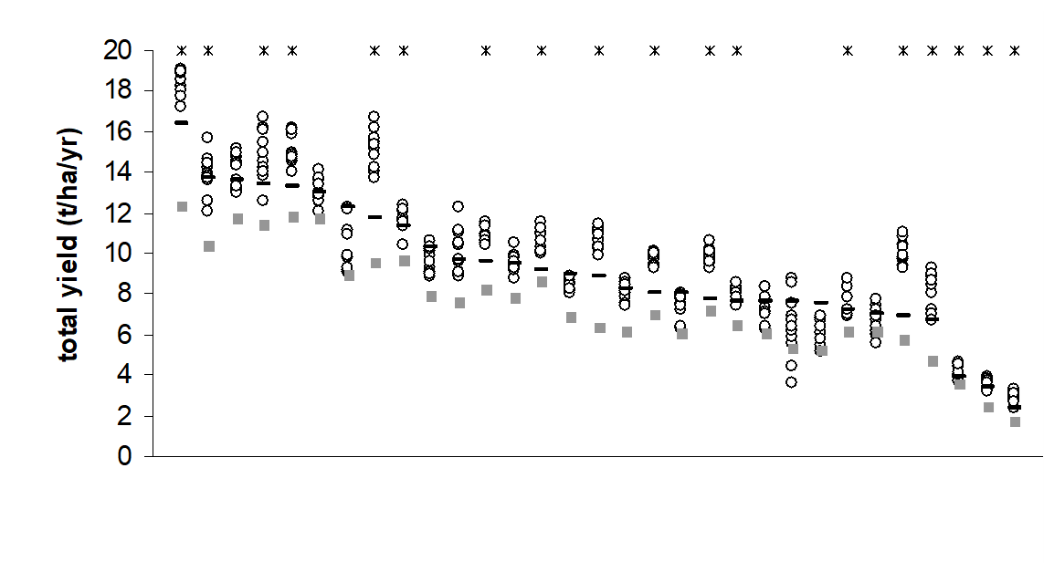
Total annual yield of 4-species mixtures generally exceeded the best-performing monoculture
mixtures
best monoculture
mean monoculture
Sites 1 - 31
Total annual yield (includes weeds) at each of 31 international sites.
Horizontal lines = best-performing monoculture
boxes = mean monoculture performance (Finn et al. 2013, J Appl Ecol)
Notes:
‘AgroDiversity’ expt.
This slide shows a graph of total annual yield (averaged across years) for each of 31 sites in an experiment that sowed 4-species mixtures of two grasses and two legumes, and monocultures of the component species. For each site, the short horizontal line indicates the yield of the best-performing monoculture; the grey box indicates the mean monoculture performance, and the circles indicate the mixture yields. Asterisks over the sites indicate where the mixtures performed better than the best-performing monoculture (within that site). The total annual yield of 4-species mixtures was significantly better than the best-performing monoculture, and was always better than the average yield of the four monocultures. The N level varied from zero N to >150 kg ha yr of N. Plots were managed by harvesting. (Finn et al. 2013, J Appl Ecol)
98% of Mix plots > average Mono
65% of Mix plots > best Mono
Mixture = ~1.20 best mono
(Best mono ≠ L. perenne)

Slide 7
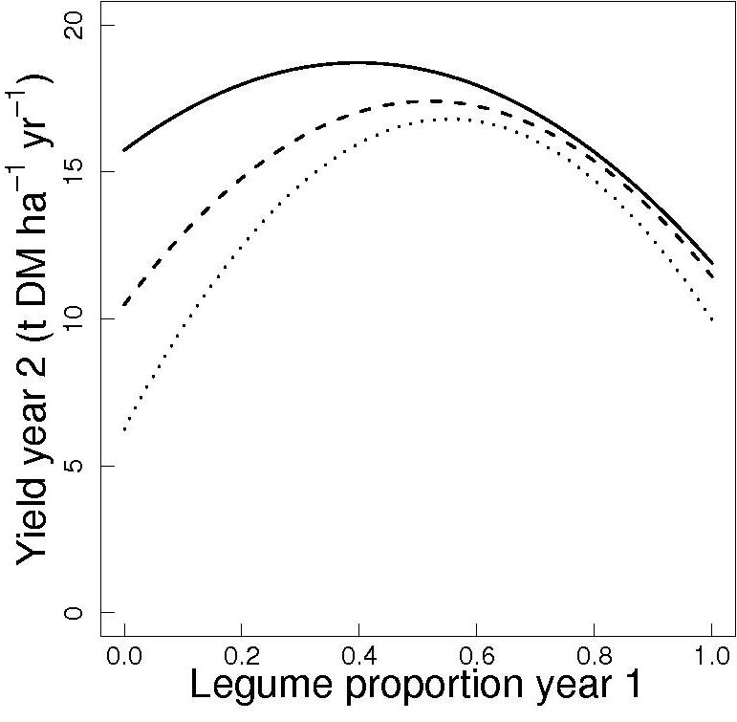
Balanced grass/legume mixtures at N50 can be as productive as grass monocultures at N450
N450
Grass only yield at
450 kg/ha N
N150
N50
From: Nyfeler et al. 2009. J. Applied Ecology
Notes:
As part of the Agrodiversity experiment, a more detailed examination of the response to clover proportion and nitrogen was conducted by Dani Nyfeler and colleagues in Switzerland.
This graph plots the proportion of legume in the sward against forage yield in harvested plots, in communities that vary in % of grass (two species) and clover (two species) from grass-only to clover-only.
The bottom left of the graph represents the grass-only swards (0% clover) and the right hand-side of bottom axis represents the clover-only swards (100% clover).
Three nitrogen levels were applied 50, 150 and 450 kg ha⁻¹ yr⁻¹ of nitrogen fertiliser (N50, N150 and N450).
The curved nature of the response shows the strong synergistic response between grasses and legumes, which was strongest at N50, and weakest at N450.
The N450 response for grass-only represents yield when nitrogen application is not limiting, shown by the red line.
A key outcome from this work is that by changing clover content within N50 swards, yields from N50 can equal or even exceed those from the grass-only sward at N450.
A distinct feature of this work is that it shows the variation in clover proportion as a continuous response.
Over time, higher nitrogen fertiliser reduced the legume proportion in swards.
Nyfeler et al. 2009. J. Applied Ecology

Slide 8
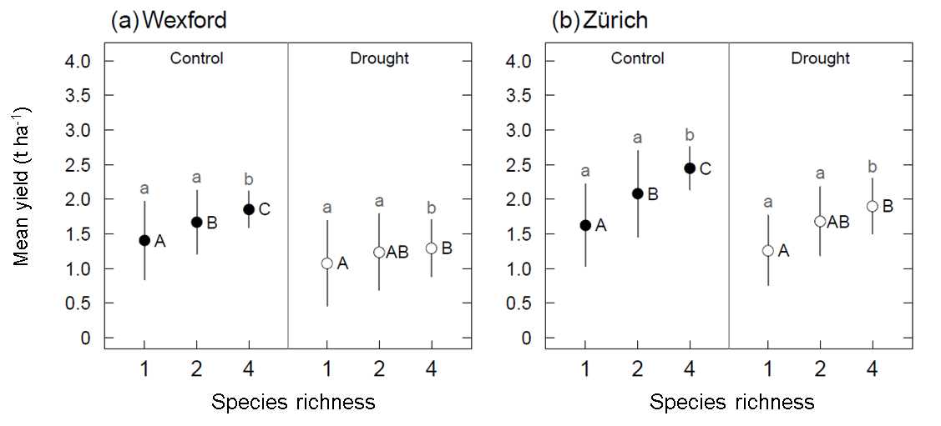
Species diversity increased mean yield & reduced yield variation = yield stability
Effects of species richness on mean yields and yield variance under rainfed conditions in Wexford, Ireland and Zurich, Switzerland. Values calculated across six harvests: three mid-season harvests × two years. (Haughey et al. 2018, Nature Scientific Reports)
Notes:
As part of the EU AnimalChange project, a joint experiment was conducted in Wexford, Ireland and Zurich, Switzerland.
The experiment manipulated the species richness and evenness of four agronomic species: perennial ryegrass, chicory, red clover and white clover.
Compared to previous experiments that manipulated evenness of grass-clover mixtures, this one included a deep-rooting herb species (chicory).
The mean yield of three mid-season harvests (selected to match the effects of a drought treatment not reported here) increased as species richness increased; the variation declined as species richness increased.
This represents a demonstration of classic yield stability. Thus, species richness conferred yield stability in harvested plots as richness increased from 1 to 4 species.
Letters beside the values that share the same letter were not significantly different. Capital letters refer to the mean values; small letters refer to the yield variances (magnitude of the error bars).
(Haughey et al. 2018, Nature Scientific Reports)

Slide 9
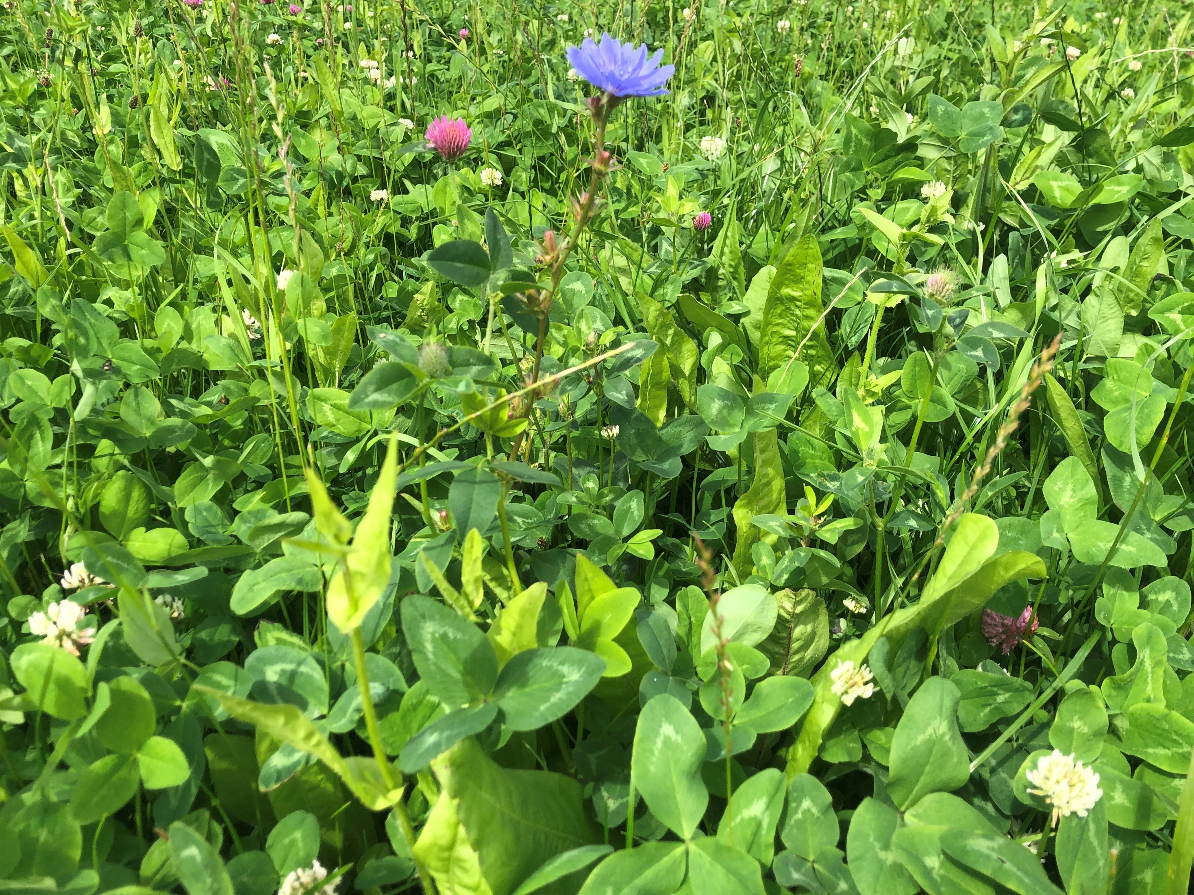
Multispecies

Slide 10
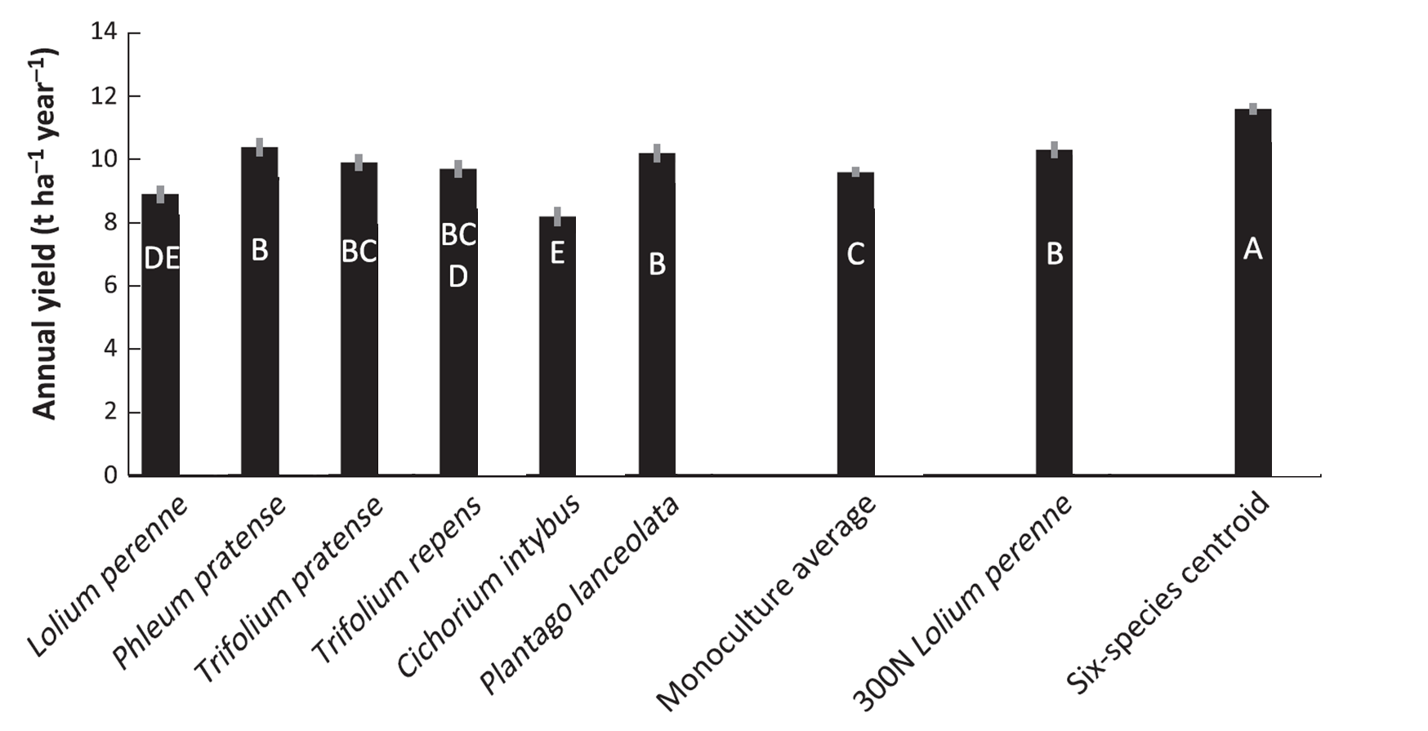
Plant diversity (6-species, grasses, legumes, herbs) enhanced total annual yield (over two years)
(Grange et al. 2021, J. Applied Ecology)
Notes:
Guylain Grange’s doctoral research in Wexford, Ireland looked at the effect of introducing herbs into multi-species mixtures. (The effects of a drought treatment are not reported here.)
The experiment manipulated the species richness and evenness of six agronomic species: perennial ryegrass, timothy, red clover, white clover, plantain and chicory. Thus, diversity varied from monocultures of all six species, to the equi-proportional six-species mixture (other intermediate levels of diversity not shown here). All plots received 150 ha⁻¹ yr⁻¹ of nitrogen fertiliser, and additional treatment applied 300 ha⁻¹ yr⁻¹ of nitrogen fertiliser to perennial ryegrass in monoculture. (300N).
The mean annual yield across two years is presented here. The six-species mixture was the best-performing community, and exceeded the yield of the 300N perennial ryegrass in monoculture.
Letters beside the values that share the same letter were not significantly different. Capital letters refer to the mean values; small letters refer to the yield variances (magnitude of the error bars).
(Grange et al. 2021, J Applied Ecology)

Slide 11
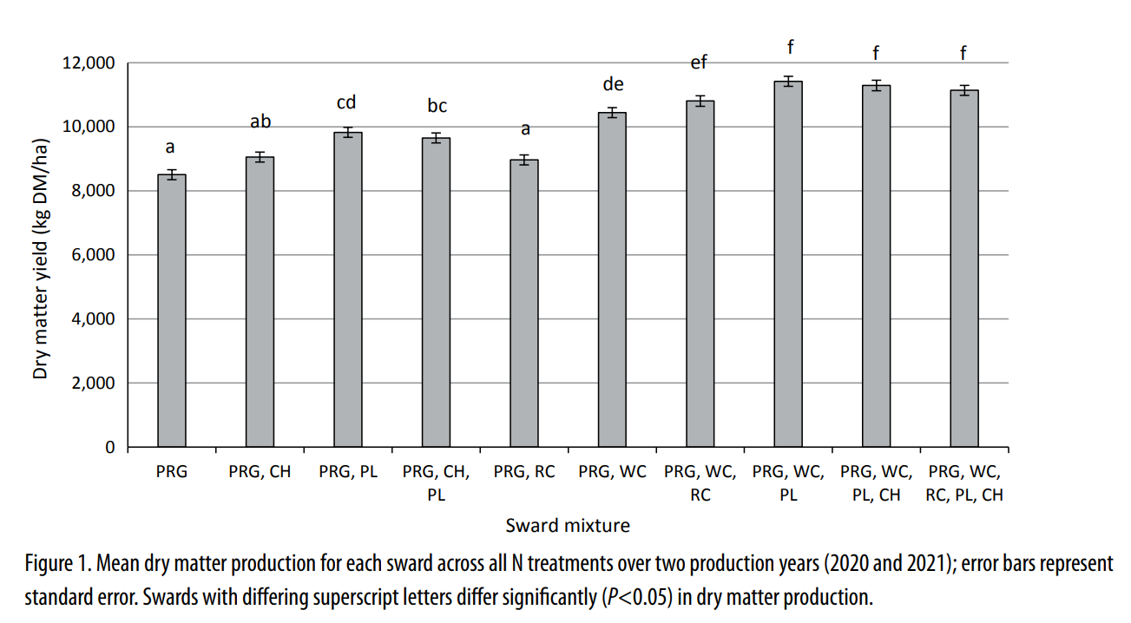
Mixtures of grasses, clover and herbs had highest forage yields in grazed plots
For references: https://www.europeangrassland.org/fileadmin/documents/Infos/Printed_Matter/Proceedings/EGF2022.pdf#page=325
From Hearn et al. (2022)
Notes:
As part of his doctoral research, Ciaran Hearn and colleagues at Moorepark, Fermoy, Ireland, conducted a grazed plot experiment to investigate the dry matter (DM) yield of multispecies swards containing three plant functional groups: grass, legume and herb, under three levels of nitrogen (N) fertilizer application (N100, N150 and N200) compared to zero N (N0).
Ten sward types were established which included a perennial ryegrass (PRG, Lolium perenne L.) monoculture and sward mixtures of the following species: PRG, white clover (WC, Trifolium repens L.), red clover (T. pratense L.), chicory (Chicorium intybus L.) and ribwort plantain (PL, Plantago lanceolate L.), with monoculture PRG N200 as the control.
Plots were grazed by lactating dairy cows. The sward mixture of PRG, WC and PL produced the highest level of DM; 2,916±198 kg DM ha-1 more than the PRG monoculture sward on average across all levels of N fertilizer. These results indicate MS swards containing both legumes and herbs can contribute increased DM production, particularly where PL and WC are included.
(This text from the abstract of Hearn et al. (2022)).

Slide 12
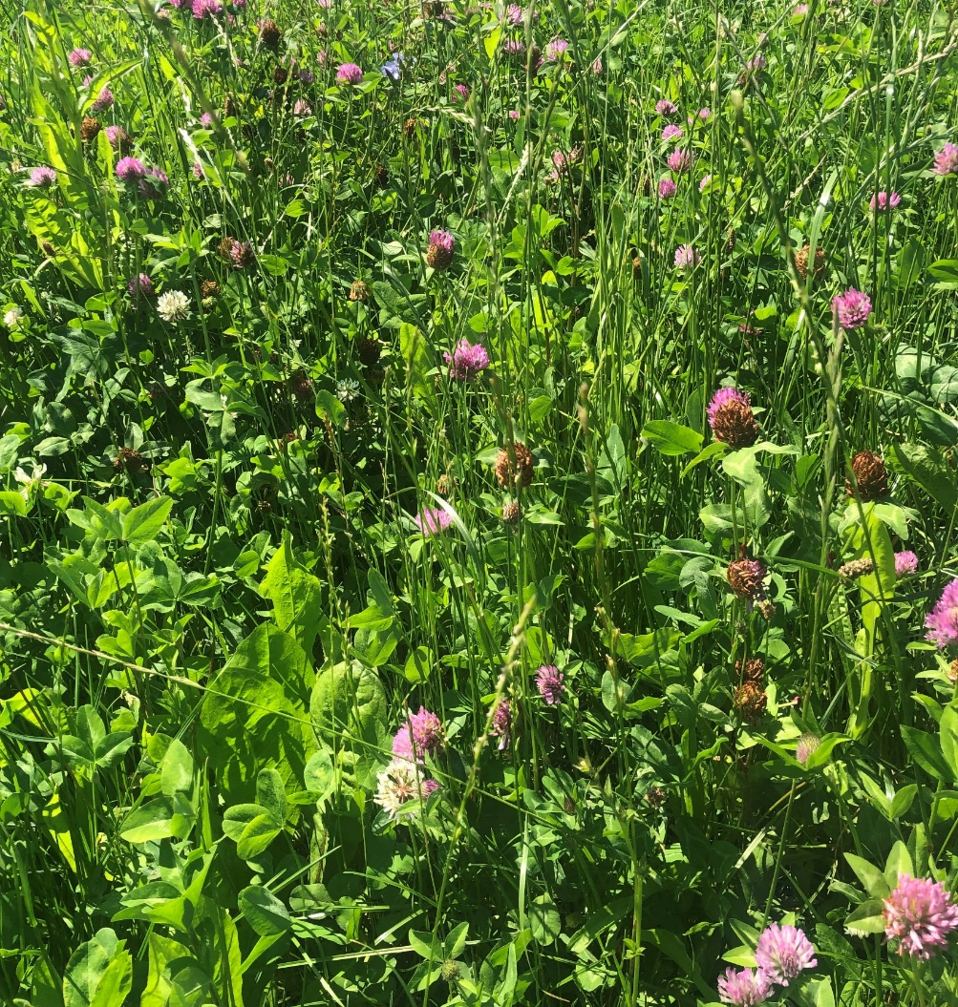
Multispecies Swards: forage yield
  A study conducted in Ireland under sheep grazing showed that multispecies swards, receiving 45% less N fertiliser input had similar forage yields to perennial ryegrass swards (Grace et al., 2018)
  A New Zealand study showed that multispecies swards had 11% higher forage yields compared to grass-clover swards (Nobily et al., 2013)

Slide 13
Lower N on mixtures out yields higher N on perennial ryegrass swards
Plot studies consistently demonstrate the ability of mixtures (perennial ryegrass, timothy, white and/or red clover, chicory and plantain) to produce similar or higher yields with lower N fertiliser application than PRG monocultures with higher N application e.g. Grange et al., 2021 (150 vs 300 kg N ha⁻¹ yr⁻¹); Moloney et al., 2021 (0 vs 360 kg N ha⁻¹ yr⁻¹); Grace et al., 2018a (90 vs 250 kg N ha⁻¹ yr⁻¹).

Slide 14
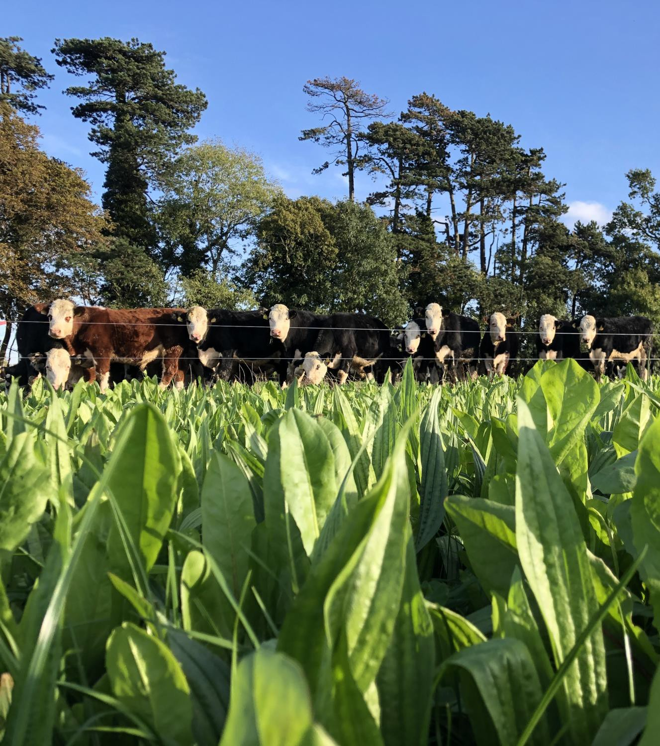


UCD Lyons Long Term Grazing Platform
Beef Grazing Study
3 farmlets established 2019 (8 ha each)
  PRG - 205 kg N/ha
  PRGWC - 90 kg N/ha
  6 species MSS - 90 kg N/ha
Stocked @ 2.5 LU/ha - dairy calf to beef
Target
  PGHM 1200 - 1800 kg DM/ha
  PGSH 4cm vs. 6cm MSS

Slide 15
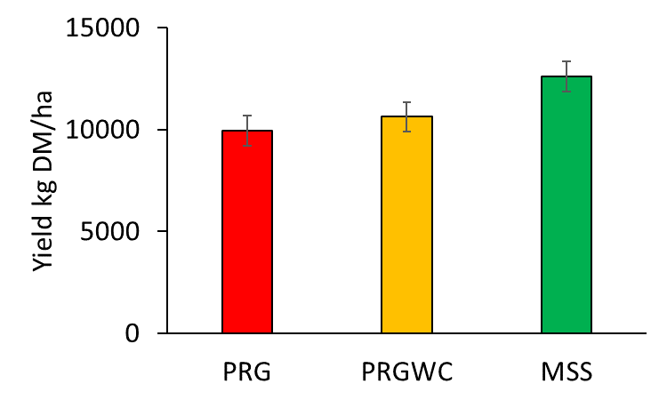
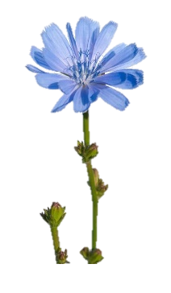
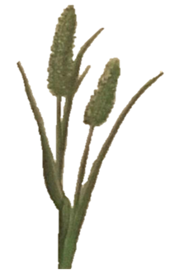
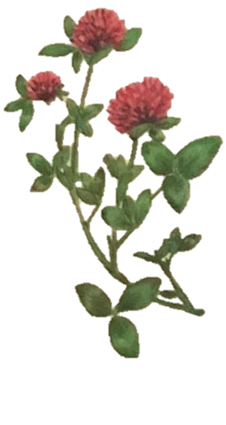
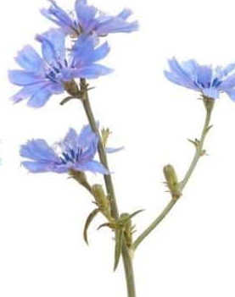
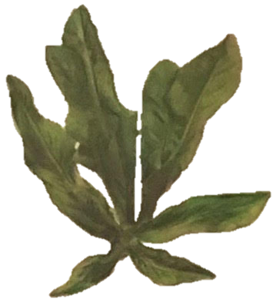
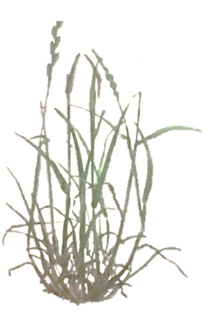
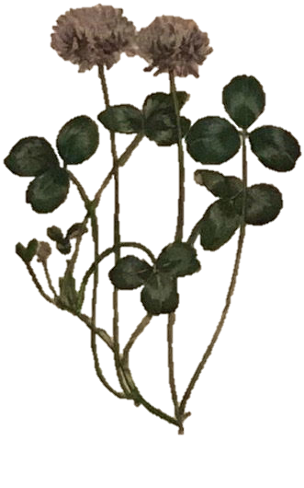
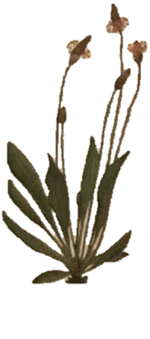
Beef Grazing Study – Forage Yield
PRG – perennial ryegrass monoculture
PRGWC – perennial ryegrass + white clover
MSS – perennial ryegrass, white clover, red clover, timothy, plantain, chicory
(Baker et al., 2023)
Notes:
This graph plots the two-year average yield produced by the three swards in this case study: PRG, PRGWC and MSS.
Under beef grazing these multispecies swards which received 55% less nitrogen fertiliser input had 27% higher forage yields compared to perennial ryegrass swards and in addition to this they had higher yields than the grass clover sward which received the same level of N fertiliser application.

Slide 16
Beef Grazing Study – Forage Quality
x
y
x
y
y
y
y
z
g kg DM⁻¹
x
x
y
z
y
xy
x
x
x
y
(Baker et al., 2023)
Notes:
There was no difference between sward types. That is the perennial ryegrass farmlet had a similar organic matter digestibility as the PRGWC and MSS farmlets (83-84%)
MSS and PRGWC had lower NDF, and similar ADF to PRG
The ADL of MSS was significantly higher than PRG and PRGWC (but you can see from the graph that this difference was numerically low).
Both legume containing swards had a higher level of CP than PRG.
The ASH concentration of MSS was greater than PRG, indicating a higher mineral content.
WSC was highest in PRG and lowest in MSS with the same true for the DM content of the swards. (note on silage* making, extra days wilt required)

Slide 17
Conclusions
There is an abundance of evidence from experimental studies to show that:
Grass-clover mixtures (with varying relative abundance) produce higher forage yield than the best-performing component monoculture (all at the same nitrogen level)
Multi-species mixtures produce higher forage yield than the best-performing component monoculture (a
Multi-species swards produce higher forage yield than the best-performing component monoculture (all at the same nitrogen level)
Multi-species swards with lower nitrogen application can produce higher forage yield than grass-only swards with higher nitrogen application.

Slide 18
Looking to the future
A key question that is currently being investigated is: what is additional effect of increasing plant diversity from a grass-clover two-species mixture to a) grass-clover mixtures with >2 species and b) grass-clover-herb mixtures.
Given the multiple agronomic and environmental expectations from grassland systems, any assessment of forage yield should also be complemented by an assessment of these other system services e.g. livestock performance, nitrogen utilisation efficiency, gaseous emissions, nitrate leaching, weed suppression, drought resistance, soil biodiversity etc.

Slide 19






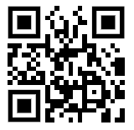




Thank you
Funded by
Supported by
https://multi4more.ie/
Project partners

