Slide 1
Multispecies Swards: Resilience to Drought
Version 1
Slides may change over time as new studies arise
Notes:
V1- created 7/7/23

Slide 2
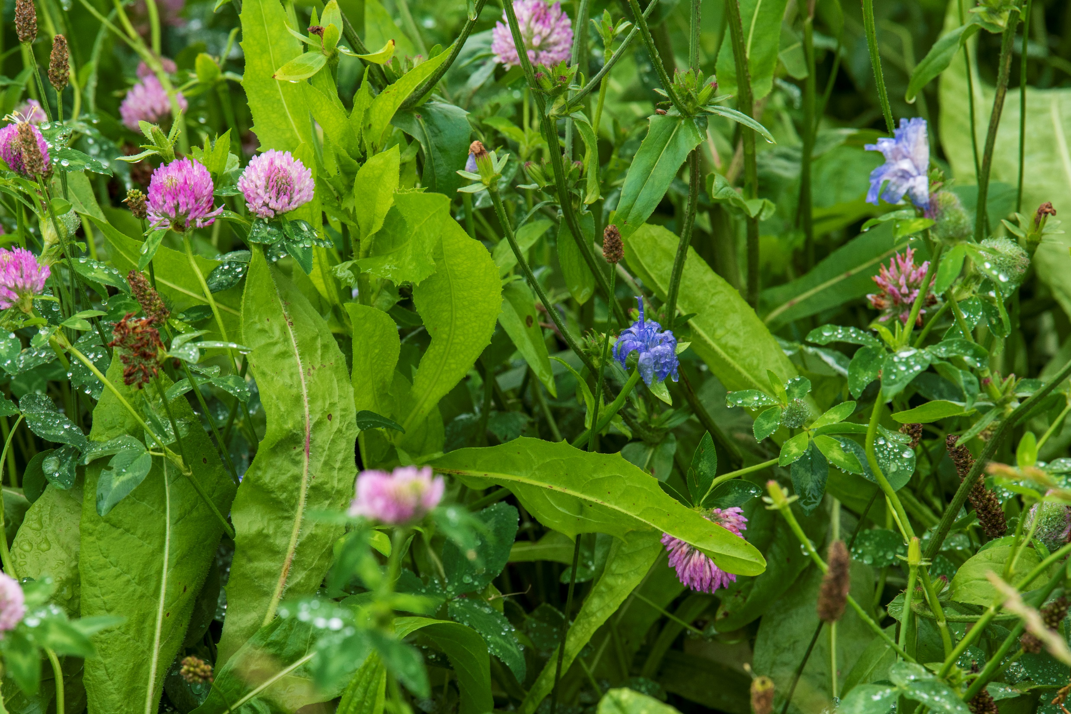
Multispecies Swards Resilience to Drought
Notes:
V1- created 7/7/23

Slide 3
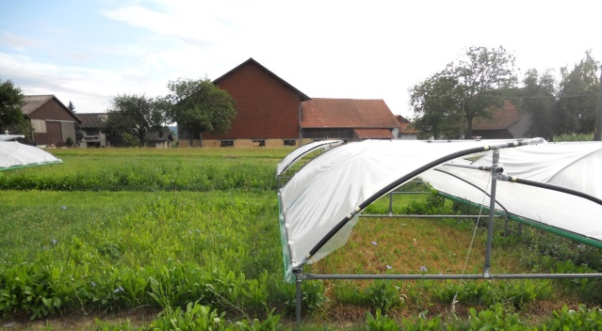
Overview
What is the effect of drought on forage yield?
Can plant diversity in multispecies swards help prevent forage losses due to drought?
Notes:
results from multiple studies that experimentally manipulated water supply through drought shelters
Comparison of the effect of diversity on ability to maintain or reduce forage losses due to drought

Slide 4
Diversity benefits resilience in semi-natural grasslands
Diversity promotes resistance and resilience of ecosystem function in the face of environmental disturbance in ecosystems and experiments based in semi-natural grasslands (e.g. Isbell et al. 2015, Craven et al., 2016).
...but it is unclear whether such benefits of diversity occur in more productive and intensively managed grassland.
Notes:
The role of diversity in promoting resistance and resilience of ecosystem function in the face of environmental
disturbance is well-established in ecosystems and experiments based in semi-natural grasslands (e.g. Craven
et al., 2016). For example, a meta-analysis of 46 plant association experiments by Isbell et al. (2015) revealed
that biomass of ‘low-diversity communities with one or two grassland plant species changed by approximately
50% during [severe] weather events, whereas that of high-diversity communities with 16-32 species changed
by only approximately 25%’.

Slide 5
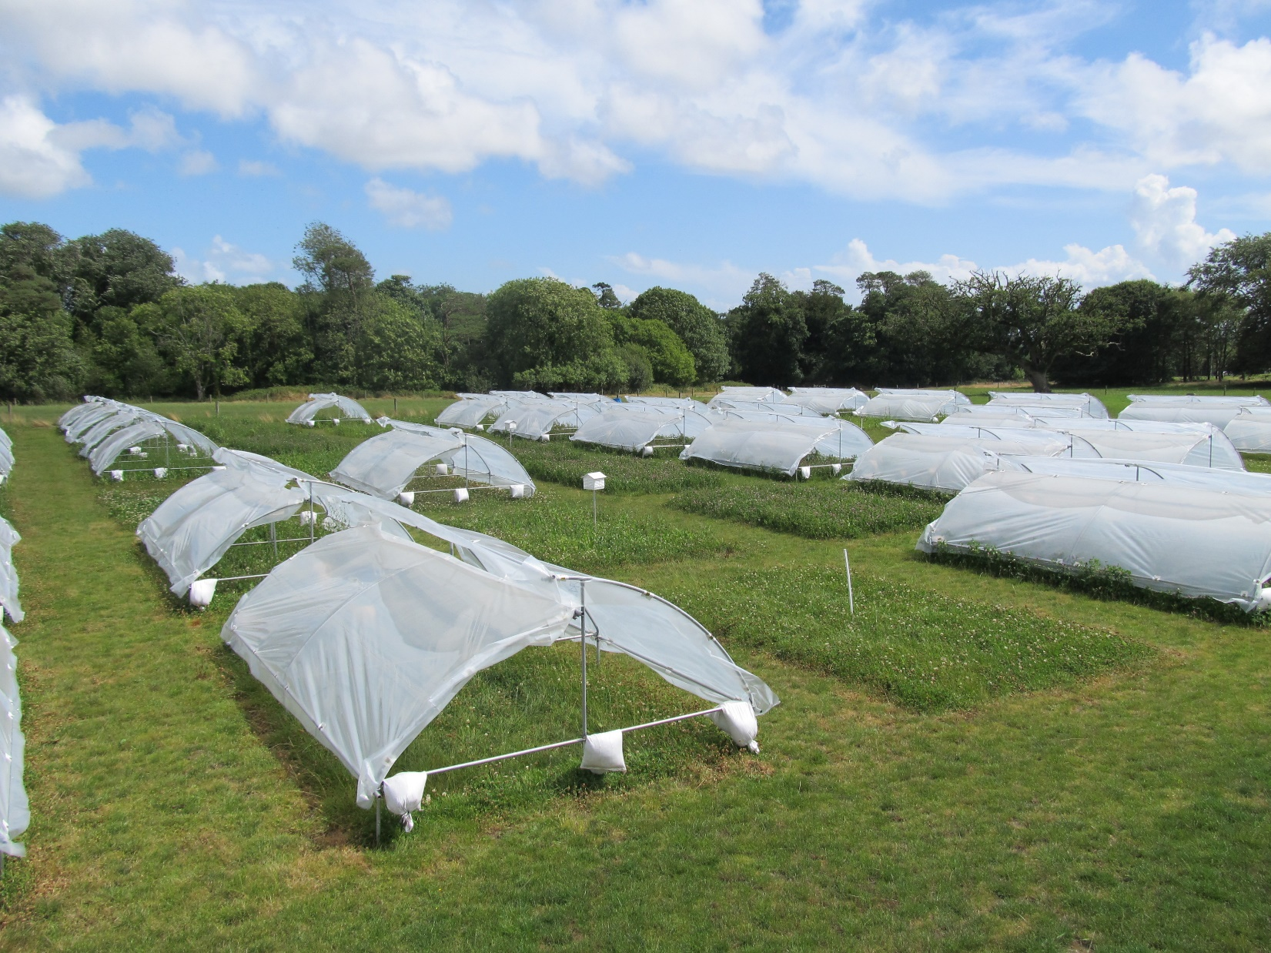
Can mixtures improve yield stability under drought?
Notes:
Photo from the Wexford site of the AnimalChange project.

Slide 6
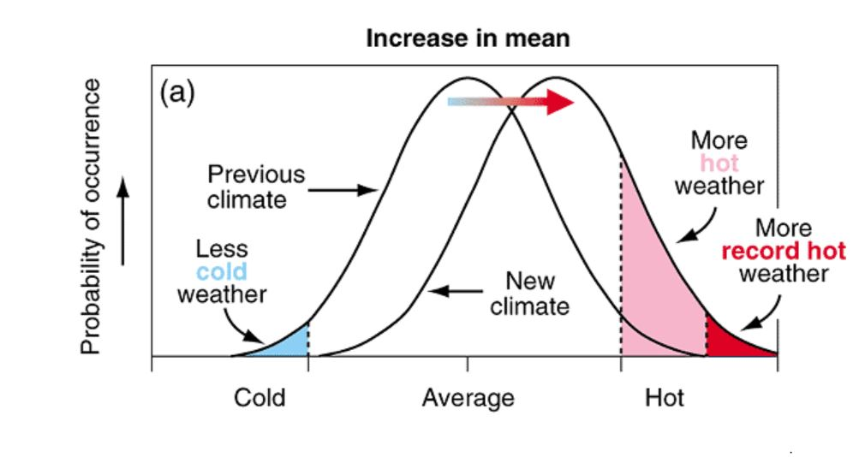
How will climate change affect grassland yield?
IPCC
Notes:
This image from one of the IPCC reports shows the effect of a change in mean temperature on the distribution of temperature. Even modest increases in the mean result in higher probabilities of extreme weather events. AS the amoun tof energy and temperature in the atmosphere increases, there is also a greater likelihood of more severe storms (wind and rainfall).

Slide 7
How will climate change affect grassland yield?
Notes:
Photo of rainfed control plot and corresponding with rainout shelter, from Swiss site of the AnimalChange experiment.

Slide 8
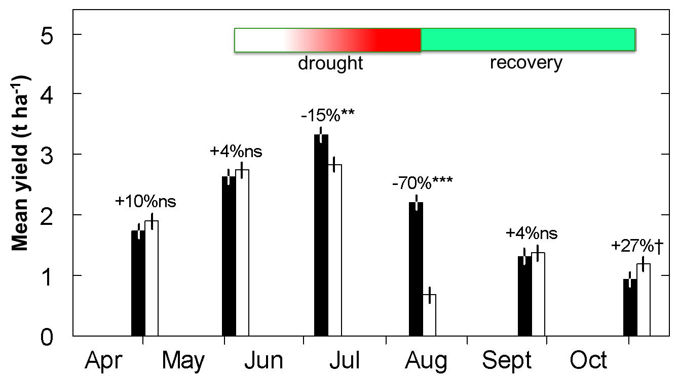
What is the effect of species diversity on drought resilience?
Hofer et al. 2016, J Appl Ecol; Finn et al. 2018.
Notes:
As part of the EU AnimalChange project, a joint experiment was conducted in Wexford, Ireland and Zurich, Switzerland.
The experiment manipulated the species richness and evenness of four agronomic species: perennial ryegrass, chicory, red clover and white clover.
Here, we provide an example of yields across multiple sward types with species richness from one to four (Irish site).
The coloured bar over the graph shows the implementation of the drought (red) and the recovery period after the drought ended (green).
Overall one can see strong effects on forage yields (-70%) at the end of the drought, but also very rapid recovery once soil moisture is restored, and even some overcompensation.
The overcompensation is relatively small across the total annual yield, and is presumed to be due to utilisation of nitrogen that was not used earlier in the season, as well as nitrogen released due to drought effects on the soil.
The red circle indicates the focus of the next analysis, and encompasses the mid-drought, end-drought and recovery harvests.
We next look at the effect of diversity on the mean and variation across these yields (two years, and two sites).

Slide 9
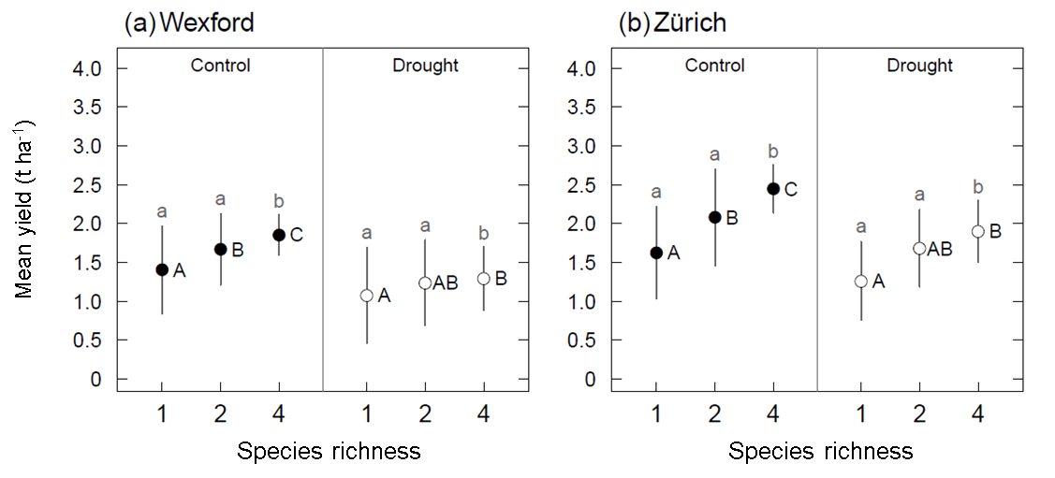
Species diversity increased mean yield & reduced yield variation = yield stability
Effects of species richness on mean yields and yield variance under rainfed conditions in Wexford, Ireland and Zurich, Switzerland. Values calculated across six harvests: three mid-season harvests × two years. (Haughey et al. 2018, Nature Scientific Reports)
Notes:
The mean yield of three mid-season harvests increased as species richness increased; the variation declined as species richness increased.
This represents a demonstration of classic yield stability. Thus, species richness conferred yield stability in harvested plots as richness increased from 1 to 4 species.
Letters beside the values that share the same letter were not significantly different. Capital letters refer to the mean values; small letters refer to the yield variances (magnitude of the error bars).
(Haughey et al. 2018, Nature Scientific Reports)

Slide 10
Species diversity increased mean yield & reduced yield variation = yield stability...even under drought
Effects of species richness on mean yields and yield variance under rainfed conditions in Wexford, Ireland and Zurich, Switzerland. Values calculated across six harvests: three mid-season harvests × two years. (Haughey et al. 2018, Nature Scientific Reports)
Notes:
The mean yield of three mid-season harvests (selected to match the effects of a drought treatment not reported here) increased as species richness increased; the variation declined as species richness increased.
There was an overall negative effect of drought on forage yields. However, the same results applies: even under drought, the mean yield of the three mid-season harvests increased as species richness increased and the variation declined as species richness increased.
Thus, plant diversity increased yield stability under rainfed and drought conditions.
In addition, the effect of plant diversity (up to 4 species) was sufficient for the four-species mixtures under drought to equal or exceed the yields of the average of the four monocultures.
Letters beside the values that share the same letter were not significantly different. Capital letters refer to the mean values; small letters refer to the yield variances (magnitude of the error bars).
(Haughey et al. 2018, Nature Scientific Reports)

Slide 11
Conclusions from the AnimalChange expt.
There were very strong yield losses in individual harvests at the end of the drought period
Rapid recovery in yield when soil moisture levels are restored
Total annual yields in these productive sites were relatively unaffected by drought (in a longer growing season, there is a smaller proportion of the season affected by a drought period)
There were large mixture effects on individual harvests and total annual yield under both rainfed and drought conditions
Positive effects of mixtures on annual yield were considerably greater (∼33%) than the effect of drought (∼11%) on annual yield.

Slide 12
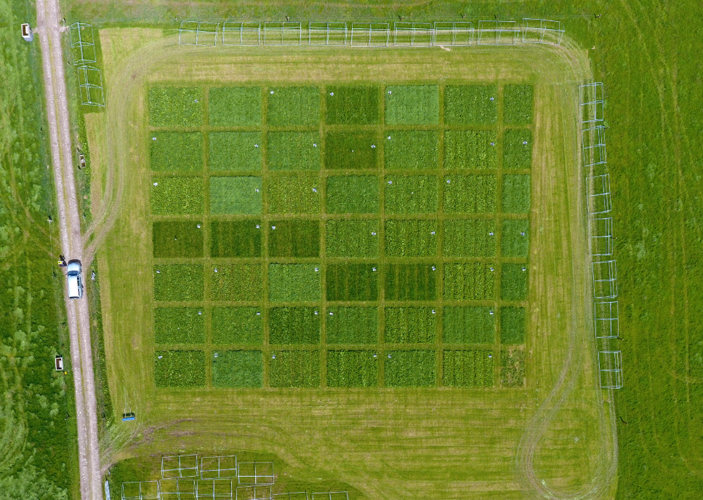
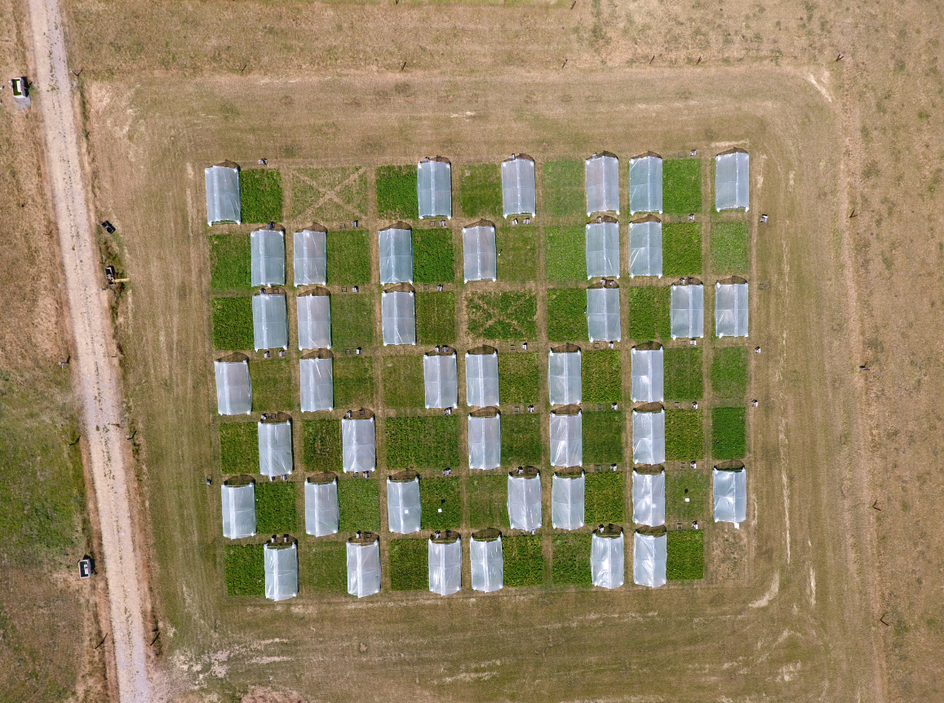
Can mixtures improve yield stability under drought?
Wexford, Ireland (early summer 2018)
Wexford, Ireland (mid-summer 2018)

Slide 13
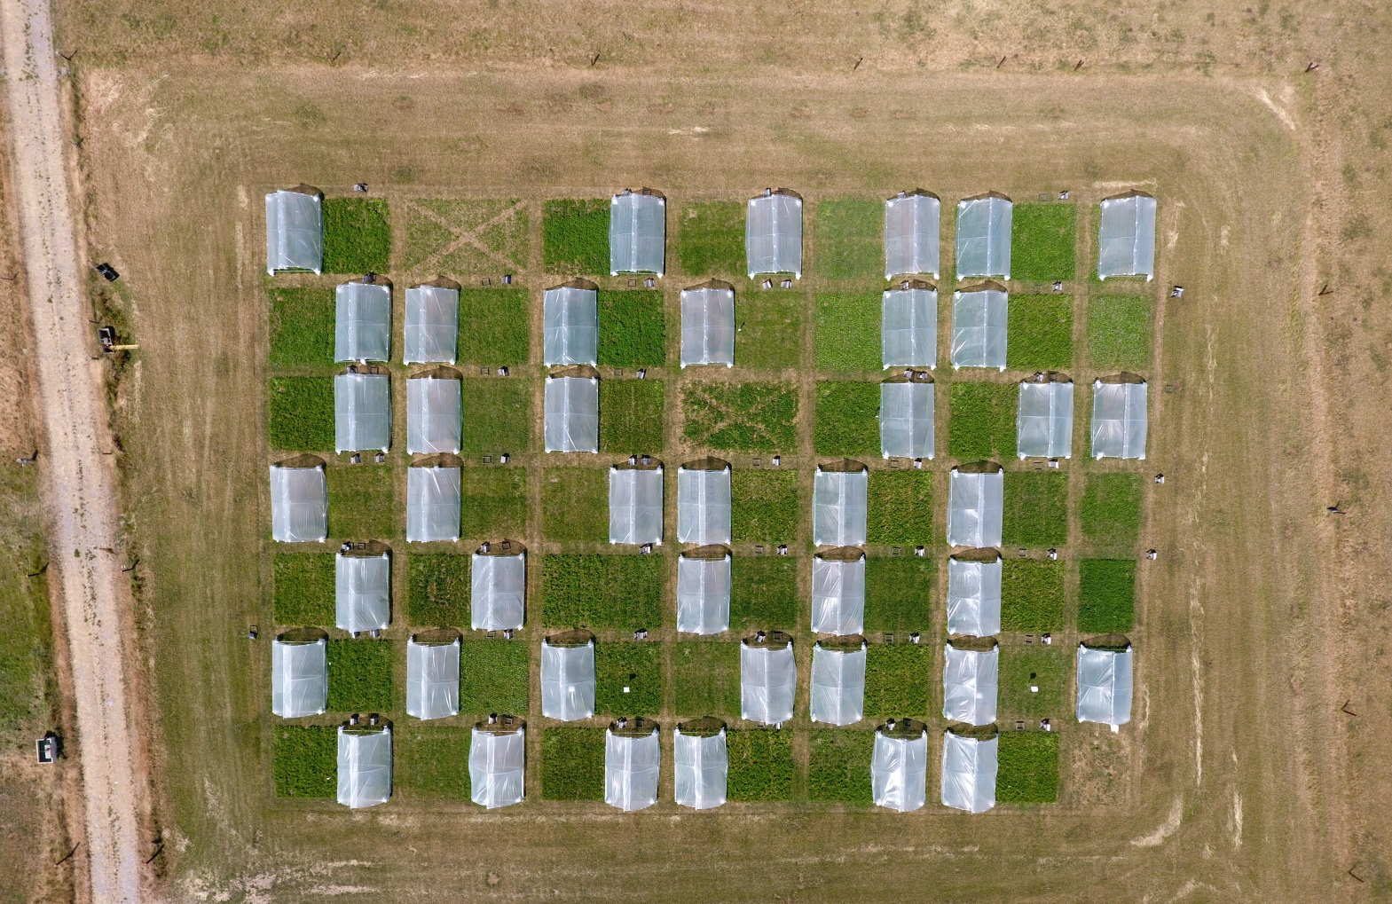
climate change affect grassland yield?
Notes:
Guylain Grange’s doctoral research at Johnstown Castle, Wexford, Ireland looked at the effect of
introducing herbs into multi-species mixtures up to 6 species (two grasses, two clovers, two herbs)
drought (9 weeks under a rain shelter)
High nitrogen (perennial ryegrass monoculture with 300 ha⁻¹ yr⁻¹ of nitrogen fertiliser
The experiment manipulated the species richness and evenness of six agronomic species: perennial ryegrass, timothy, red clover, white clover, plantain and chicory. Thus, diversity varied from monocultures of all six species, to the equi-proportional six-species mixture (other intermediate levels of diversity not shown here). All plots received 150 ha⁻¹ yr⁻¹ of nitrogen fertiliser, and additional treatment applied 300 ha⁻¹ yr⁻¹ of nitrogen fertiliser to perennial ryegrass in monoculture. (300N). These points can be represented on a ternary diagram, as shown in the slide.
The sown communities comprised six monocultures and 13 mixtures, from two to six species. Following a simplex design (Cornell, 2011), species proportions were 100% of the advised seeding weight for monocultures; 50% of each species from the same FG for the two-species mixtures; 25% of each species from two FGs for the four-species mixtures and 16.7% of each species for the six-species mixtures centroid. The five-species mixtures were dominated by each species in turn such that there was 60% of one species and 10% of the four species from the other two FGs.

Slide 14
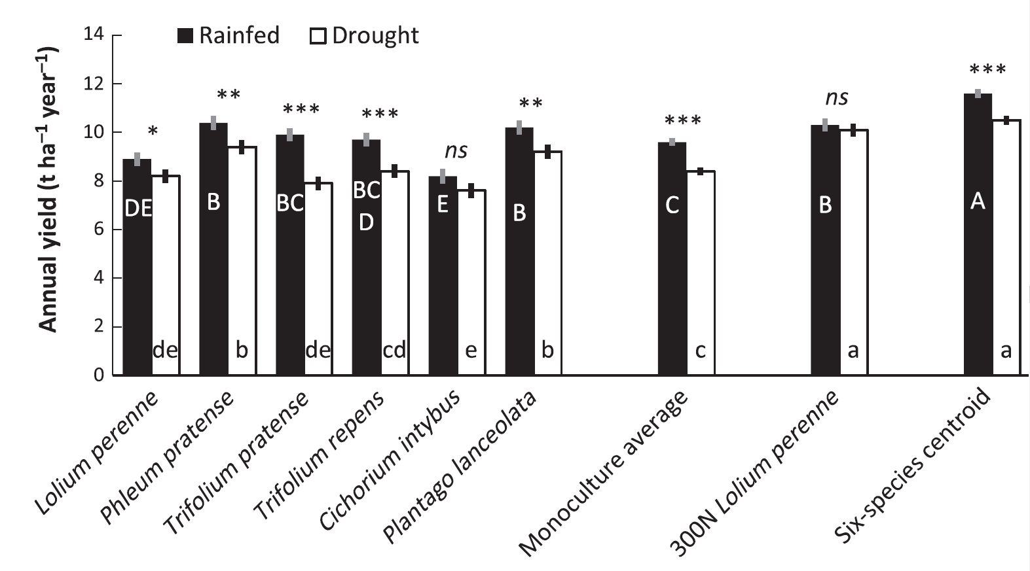
Plant diversity (6-species, grasses, legumes, herbs) enhanced total annual yield (over two years)
(Grange et al. 2021, J. Applied Ecology)
Notes:
The mean annual yield across two years is presented here.
Each of the six monocultures are shown, as well as the average of the six monocultures, the 300N perennial ryegrass, and the equi-proportional six-species mixture.
Overall, highest yields (in this graph) were from the equi-proportional six-species mixture, in both rainfed and drought conditions.
The yield of the equi-proportional six-species mixture at 150N was either greater than or equal to that of the 300N perennial ryegrass.
Asterisks indicate the significance of the effect of drought (ns = not significant).
Letters beside the values that share the same letter were not significantly different. Capital letters refer to the mean yields of the plant communities under rainfed control; small letters refer to the mean yields of the drought plots. Within each group (rainfed or drought), letters beside the values that share the same letter were not significantly different.
(Grange et al. 2021, J Applied Ecology)

Slide 15
Diversity promoted yields under drought Grange et al. 2021, J. Appl. Ecology
Two years, rainfed
Two years, 9-week drought
Grass
Grass
*
*
Legume
Legume
Herb
Herb
300N L. perenne
*
*
tonnes/ha of harvested forage (dry matter)
Notes:
The ternary diagram in the earlier slide shows the distribution of sampling points; these points can be used to create a response surface.
The benefit of this modelling approach is that one can predict for community compositions that were not included in the original design.
Main slide
Shows a colour legend that corresponds to total annual yield of forage for rainfed control (left) and the drought treatment (right).
One can see that the predicted maximum yield (greenest point) is close to the equi-proportional six-species mixture.
There is also an obvious overall effect of drought, but still a strong response to diversity under drought.
Large parts of this ternary diagram (the mixture performance) exceeded that of the best-performing monoculture.
Click 1: the centroid point (equi-proportional six-species mixture) on the ternary diagram and on the legend for rainfed control.
Click 2: the centroid point (equi-proportional six-species mixture) on the ternary diagram and on the legend for drought treatment.
Click 3: the 300N perennial ryegrass yield (the same under rainfed and drought)

Slide 16
Conclusions
Drought severity is related to effects on plant yield in temperate grasslands, and severe drought events have strong effects on yield
There is rapid recovery in yield when soil moisture levels are restored
Plant diversity (even from one or two to six species) has strong positive effects on yield under both rainfed and drought conditions
Positive effects of mixture diversity on total annual yield tends to be greater than the negative effect of drought.

Slide 17
Looking to the future
The choice of a successful strategy for grasslands to adapt to drought strongly depends on the type of stress (e.g. Mediterranean versus temperate regions).
“Future research on the value of diversity in productive grasslands needs to include the interactions of drought stress with other factors (other stresses, soil type, management), and improve measurement of the effect of diversity on multiple ecosystem services (multifunctionality) that include agronomic, environmental and socioeconomic responses.” (Lüscher et al. 2022)

